Slide 1
Bioceramic Technology
Scientific proof bioceramics emit Far Infrared Rays which reacts with water to produce hydrogen peroxide.

Slide 2
PURPOSE
Show scientific knowledge that Far Infrared Rays (FIR) are a proven scientific fact.
Show independent lab testing proving bioceramics from Crystal Wash emits FIR.
Show scientific knowledge that has already proven FIR reacts with water to produce hydrogen peroxide (H2O2).
Provide scientific documentation proving FIR to H2O2 is an instantaneous reaction.

Slide 3
BACKGROUND
Many processes in chemistry are chains of individual reactions rather than an instantaneous stand-alone act. Chemical reactions are part of life. When a process starts, more often than not, it doesn’t stop there. It continues to move in a chain reaction resulting in many possible directions.

Slide 4
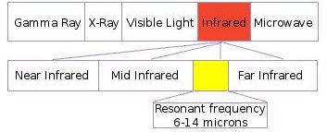
1. Far Infrared Rays are proven
FIR is defined in encyclopedias as “a region in the infrared spectrum of electromagnetic radiation, radiation energy with a wavelength of 15 micrometers (µm) to 1 mm.”
http://en.wikipedia.org/wiki/Far_infrared

Slide 5
2. Lab Report Showing Bioceramics Emit FIR
Please refer to [Exhibit A] in the highlighted “Test Results,” independent lab testing show bioceramics from “Laundry Ball,” emits radiation energy at 5-20 micrometers, the definition of FIR.

Slide 6
3. FIR to H2O2 is proven
Please refer to [Exhibit B], a published article in the “Journal of Medical and Biomedical Engineering” in 2000, under the highlighted words… “H2O2-sacavenging activity directly increased by 10.26% after FIR application.”

Slide 7
3. FIR to H2O2 is proven
* Given energy, such as FIR from bioceramics, water molecules react to produce H2O2

Slide 8
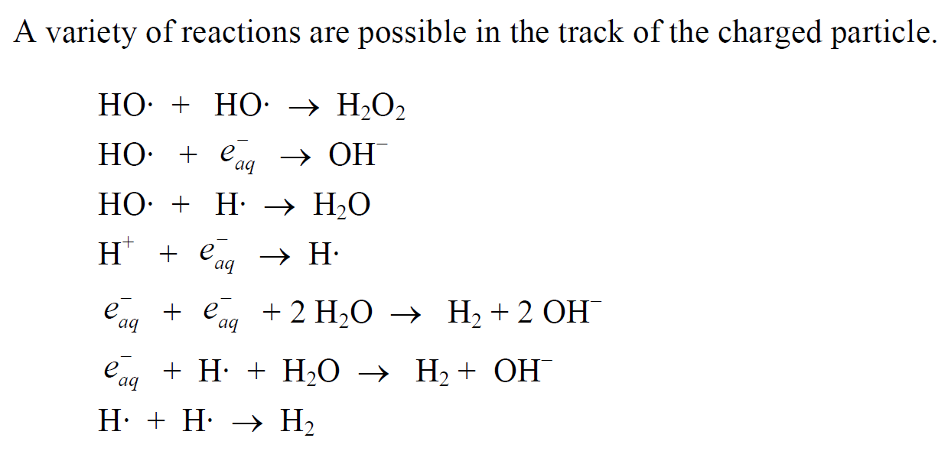
3. FIR to H2O2 is proven
One of which, is H2O2.

Slide 9
4. H2O2 is reversible
Oxidation-reduction, or Redox, is a famous reaction in chemistry. It simply means gaining or losing electrons and the reaction can go both ways.
Formation and deformation of hydrogen peroxide, or H2O2 is a Redox reaction.
Please refer to [Exhibit C], taken from an encyclopedia

Slide 10
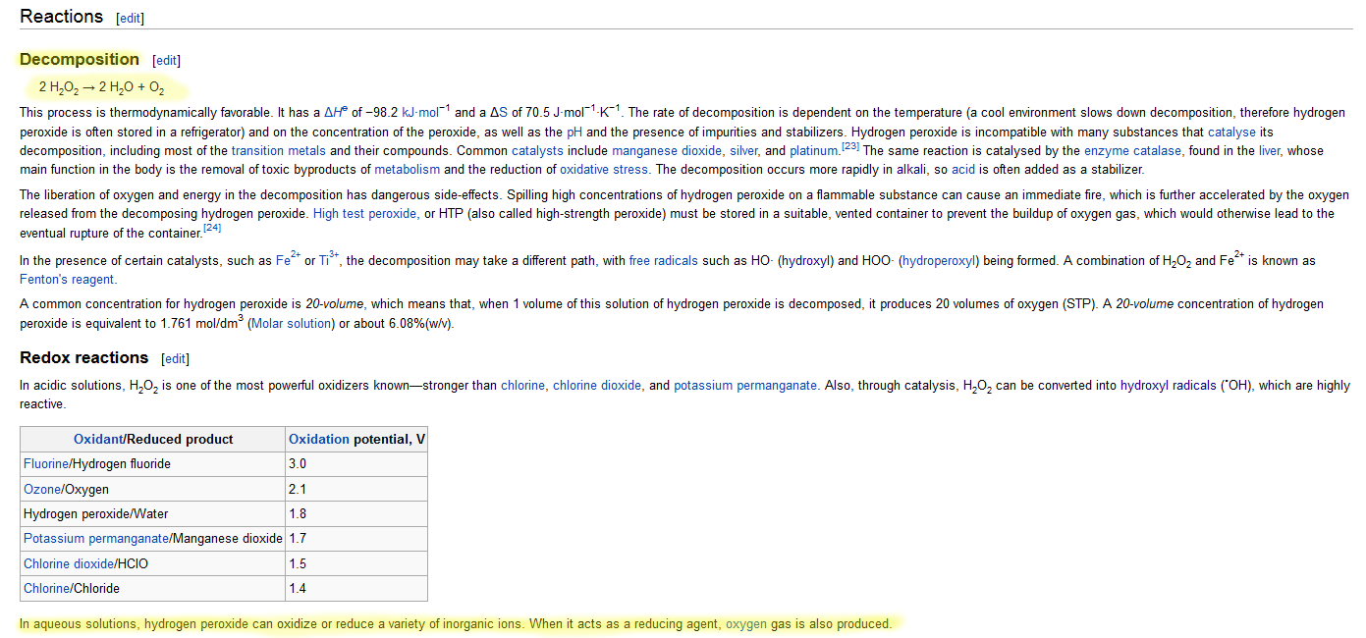
4. H2O2 is reversible
Exhibit C from Wikipedia Encyclopedia
http://en.wikipedia.org/wiki/Hydrogen_peroxide#Reactions

Slide 11
CONCLUSION
FIR is a real, proven scientific fact.
FIR increases H2O2 production in water, is a proven scientific fact.
Independent Lab testing proves bioceramics from Super Wash Ball and Disk emits FIR to produce H2O2.
FIR to H2O2 is a reversible reaction which makes detection difficult.

